Slide 1
Lecture 12
Visualization Starter Pack

Slide 2
Learning Objectives Today
Revisit Histogram
Pie Chart, 2d Histogram
Matplotlib Text Function

Slide 3
Histogram
Check Lecture14_Scripts1.ipynb

Slide 4
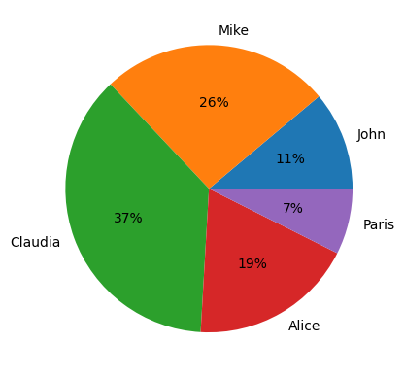
Pie Chart
x = np.array([3,7,10,5,2])
lb = ['John', 'Mike', 'Claudia', 'Alice', 'Paris']
plt.pie(x, labels=lb, autopct='%1.0f%%')
plt.show()

Slide 5
Histogram 2d
Imagine, you have temparate data for n days. You also have death counts for n days. Can you create a histogram that will show the death intensity among periods (bins) of temparatures.
Check Lecture14_Scripts1.ipynb

Slide 6
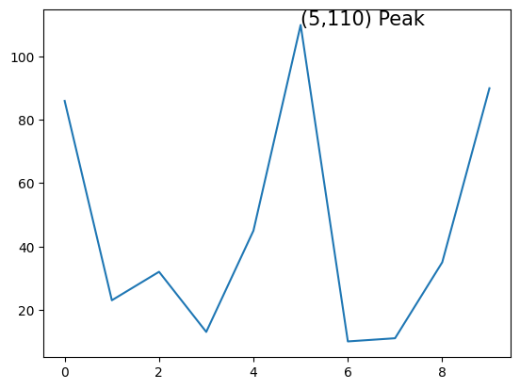
Matplotlib Text Method
plt.text(5, 110, "({},{}) Peak".format(5,110), fontsize=15)

Slide 7
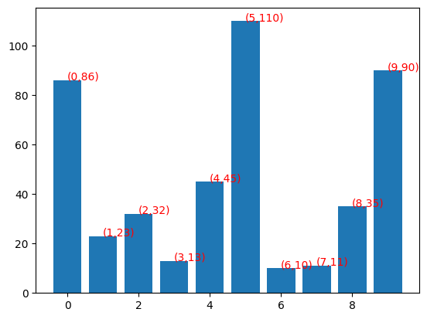
Matplotlib Text Styling
style = dict(size=10, color='red')
for i,j in zip(x,y):
plt.text(i, j, "({},{})".format(i,j), ha='left', **style )

Slide 8
Matplotlib Annotation
fig, ax = plt.subplots()
ax.plot(x, y)
ax.annotate('local maximum', xy=(5, 110), xytext=(7.5, 100),
arrowprops=dict(facecolor='black', shrink=0.05))
ax.annotate('Minimum', xy=(6,10), xytext=(6.5, 60),
arrowprops=dict(arrowstyle="->", connectionstyle="angle3,angleA=0,angleB=-90"));

Slide 9
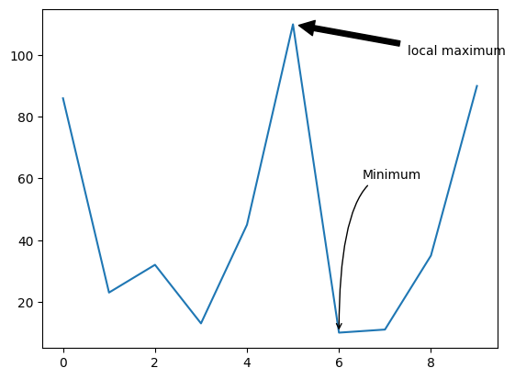
Matplotlib Annotation

Slide 10
Matplotlib Tick Modification
# Customize x-axis ticks (month labels)
plt.xticks(np.arange(len(months)), months) # Set tick positions at each month index
# Adjust y-axis ticks (temperatures)
plt.yticks(np.arange(10, 35, 5)) # Set ticks every 5 degrees between 10 and 34

Slide 11
Matplotlib Tick Modification
# Customize x-axis ticks with rotation for better readability
plt.xticks(np.arange(len(quarters)), quarters, rotation=45) # Rotate 45 degrees
# Set y-axis ticks with custom formatting (thousands separator)
def y_axis_formatter(value, pos):
return f"{value:,.0f}" # Format as comma-separated thousands
plt.gca().yaxis.set_major_formatter(y_axis_formatter) # Apply formatter to y-axis

